Slide 1
Maths and Statistical Foundations for Analytics
Lecture 8: Regression

Slide 2
8.1 Linear Equations with One Independent Variable

Slide 3
Definition 8.1
y-Intercept and Slope
For a linear equation
the number
is called the y-intercept and the number
is called the slope.

Slide 4
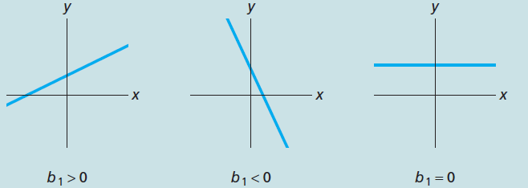
Key Fact 8.1
Graphical Interpretation of Slope
The graph of the linear equation
slopes upward if
slopes downward if
and is horizontal if
as shown
in Fig. 4.6.

Slide 5
8.2 The Regression Equation

Slide 6
Definition 8.2
Scatterplot
A scatterplot is a graph of data from two quantitative variables of a population. In a scatterplot, we use a horizontal axis for the observations of one variable and a vertical axis for the observations of the other variable. Each pair of observation is then plotted as a point.

Slide 7
Table 8-2
Age and price data for a sample of 11 Orions
Car | Age(yr) X | Price($100) y
1 | 5 | 85
2 | 4 | 103
3 | 6 | 70
4 | 5 | 82
5 | 5 | 89
6 | 5 | 98
7 | 6 | 66
8 | 6 | 95
9 | 2 | 169
10 | 7 | 70
11 | 7 | 48

Slide 8
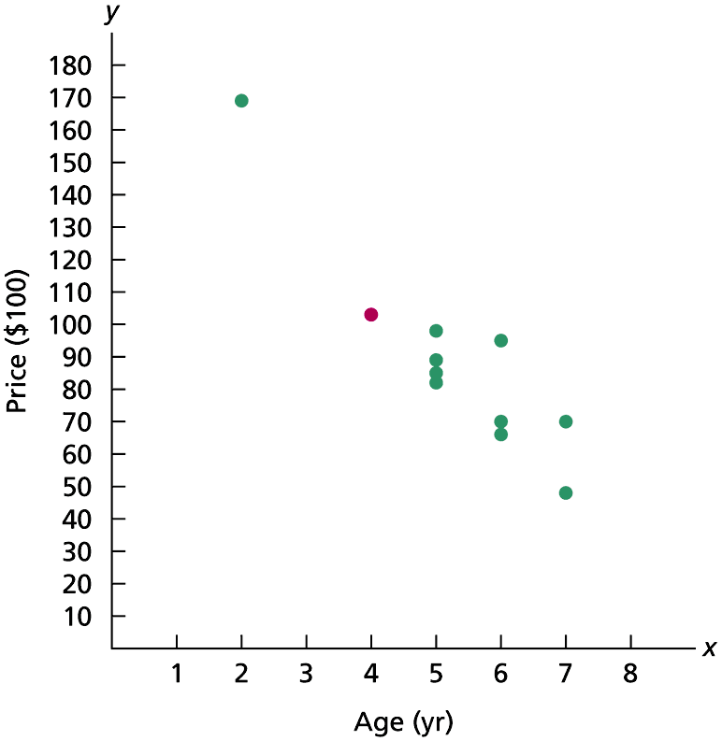
Figure 8-7
Scatterplot for the age and price data of Orions

Slide 9
Table 8-3 & Figure 8-8
Three data points
Scatterplot for the data points
x | y
1 | 3
2 | 1
3 | 5

Slide 10
Figure 9-9
Two possible lines to fit the data points

Slide 11
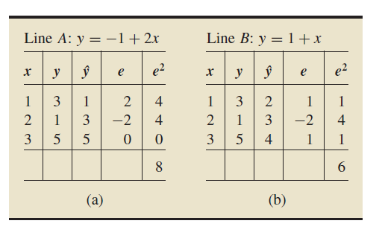
Table 8-4
Determining how well the data points are fit by (a) Line A and (b) Line B

Slide 12
Key Fact 8.2 & Definition 8.3
Least-Squares Criterion
The least-squares criterion is that the line that best fits a set of data points is the one having the smallest possible sum of squared errors.
Regression Line and Regression Equation
Regression line: The line that best fits a set of data points according to the least-squares criterion.
Regression equation: The equation of the regression line.

Slide 13
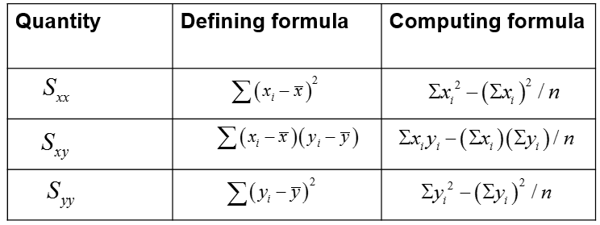
Definition 8.4
Notation Used in Regression and Correlation
For a set of n data points, the defining and
computing formulas for
are as follows.

Slide 14
Formula 8.1
Regression Equation
The regression equation for a set of n data points is
where
These two equations give the slope and y-intercept of the regression line, respectively.

Slide 15
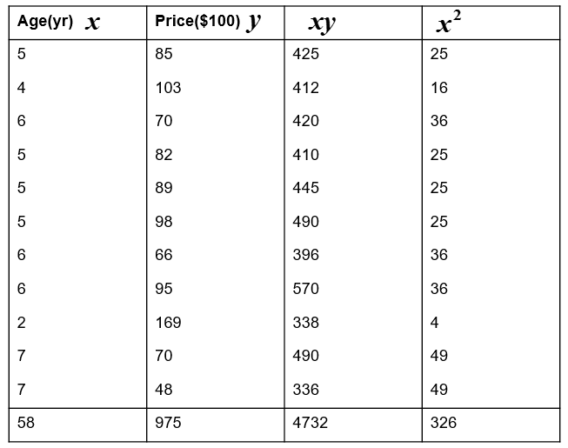
Table 8-6
Table for computing the regression equation for the Orion data

Slide 16
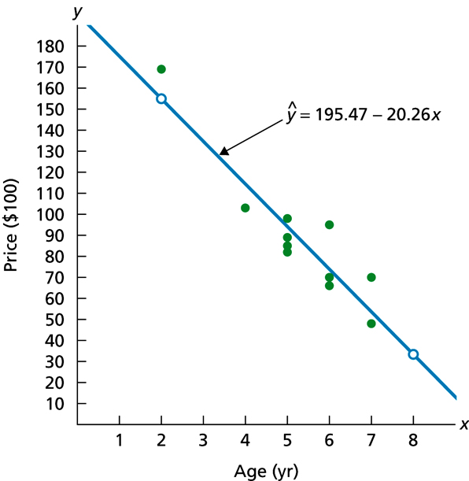
Figure 8-11
Regression line and data points for Orion data

Slide 17
Definition 8.5
Response Variable and Predictor Variable
Response variable: The variable to be measured or observed.
Predictor variable: A variable used to predict or explain the values of the response variable.

Slide 18
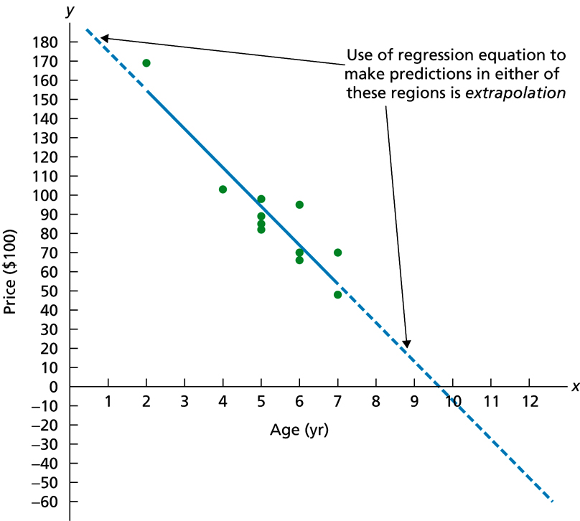
Figure 8-12
Extrapolation in the Orion example

Slide 19
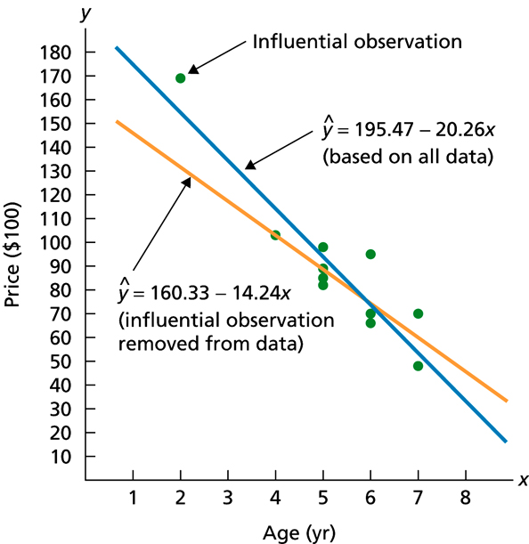
Figure 8-13
Regression lines with and without the influential observation removed

Slide 20
Key Fact 8.3
Criterion for Finding a Regression Line
Before finding a regression line for a set of data points, draw a scatterplot. If the data points do not appear to be scattered about a line, do not determine a regression line.

Slide 21
8.3 The Coefficient of Determination

Slide 22
Definition 8.6
Sums of Squares in Regression
Total sum of squares, S S T: The total variation in the observed values of the
response variable:
Regression sum of squares, S S R: The variation in the observed values of
the response variable explained by the regression:
Error sum of squares, S S E: The variation in the observed values of the
response variable not explained by the regression:

Slide 23
Definition 8.7
Coefficient of Determination
The coefficient of determination,
is the proportion of variation in the
observed values of the response variable explained by the regression. Thus,

Slide 24
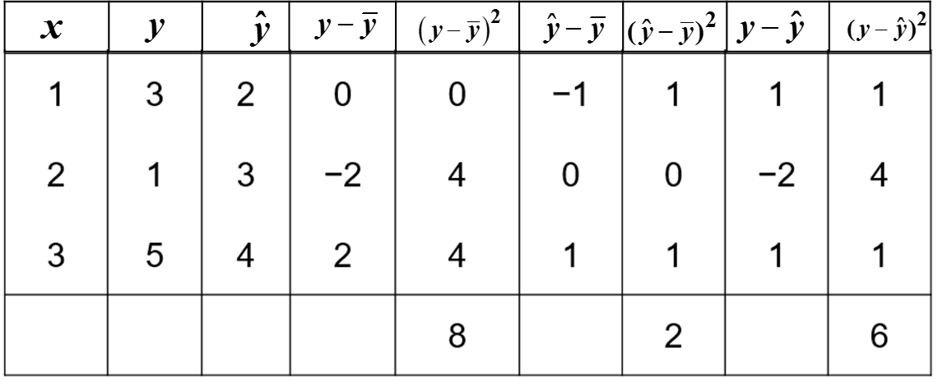
Table 8-7
Table for finding the three sums of squares

Slide 25
8.4 Linear Correlation

Slide 26
Definition 8.8 & Formula 8.3
Linear Correlation Coefficient
For a set of n data points, the linear correlation coefficient, r, is defined by
where
denote the sample standard deviations of the x-values and
y-values, respectively.
Computing Formula for a Linear Correlation Coefficient
The computing formula for a linear correlation coefficient is

Slide 27
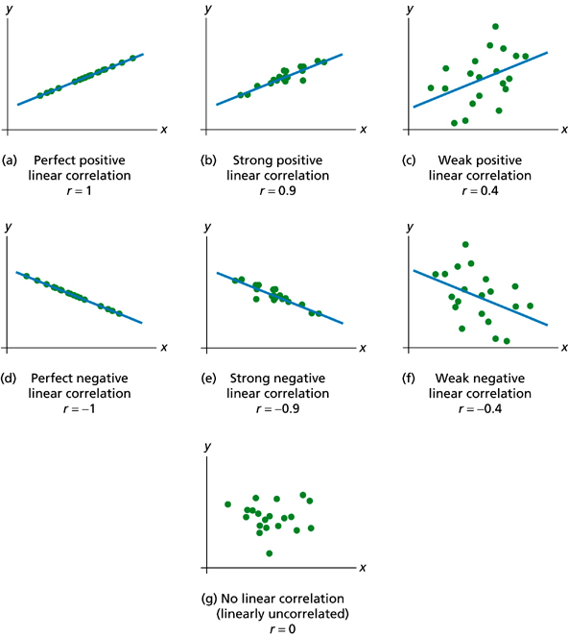
Figure 8-18
Various degrees of linear correlation

Slide 28
Key Fact 8.5
Relationship between the Correlation Coefficient and the Coefficient of Determination
The coefficient of determination equals the square of the linear correlation coefficient.

Slide 29
8.5 The Regression Model; Analysis of Residuals

Slide 30
Definition 8.5.1
Conditional Distribution, Mean, and Standard Deviation
Suppose that x and y are predictor and response variables, respectively, on a
population. Let
denote a particular value of the predictor variable and
consider the subpopulation consisting of all members of the population whose
value of the predictor variable is
Conditional distribution of the response variable corresponding to
The distribution of all possible values of the response variable on the aforementioned subpopulation.
Conditional mean of the response variable corresponding to
The mean of all possible values of the response variable on the aforementioned subpopulation.
Conditional standard deviation of the response variable corresponding to
The standard deviation of all possible values of the response variable on the aforementioned subpopulation.

Slide 31
Key Fact 8.5.1
Assumptions (Conditions) for Regression Inferences
Population regression line: There are constants
for each value x of the predictor variable, the conditional mean of the
response variable is
Equal standard deviations: The conditional standard deviations of the response variable are the same for all values of the predictor
variable. We denote this common standard deviation
Normal populations: For each value of the predictor variable, the conditional distribution of the response variable is a normal distribution.
Independent observations: The observations of the response variable are independent of one another.

Slide 32
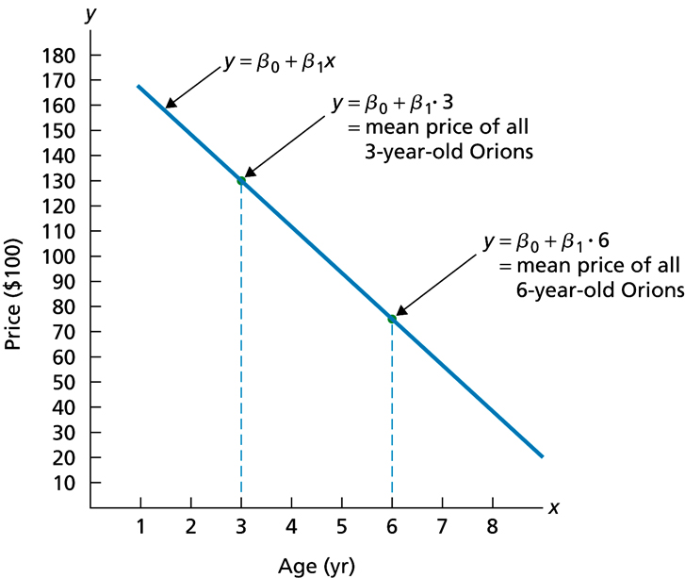
Figure 8.5-1
Population regression line

Slide 33
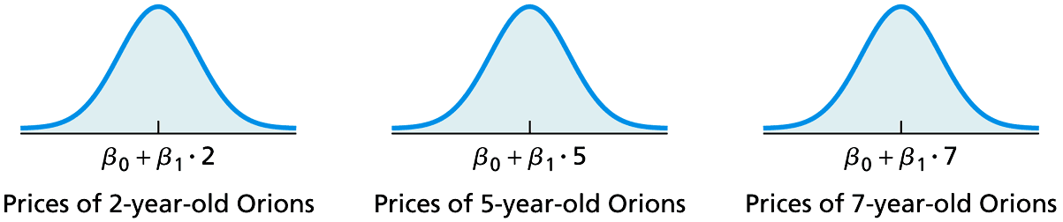
Figure 8.5-2
Price distributions for 2-, 5-, and 7-year-old Orions under Assumptions 2 and 3 (The means shown for the three normal distributions reflect Assumption 1)

Slide 34
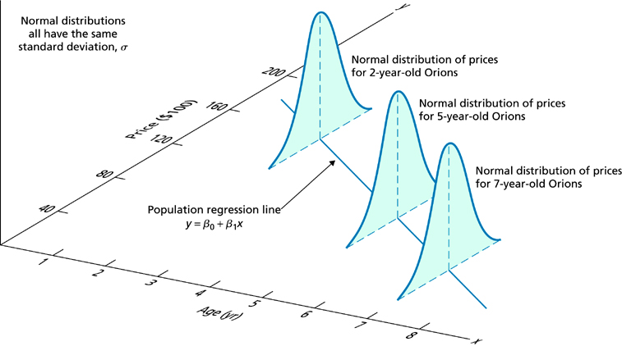
Figure 9.5-3
Graphical portrayal of Assumptions 1-3 for regression inferences pertaining to age and price of Orions

Slide 35
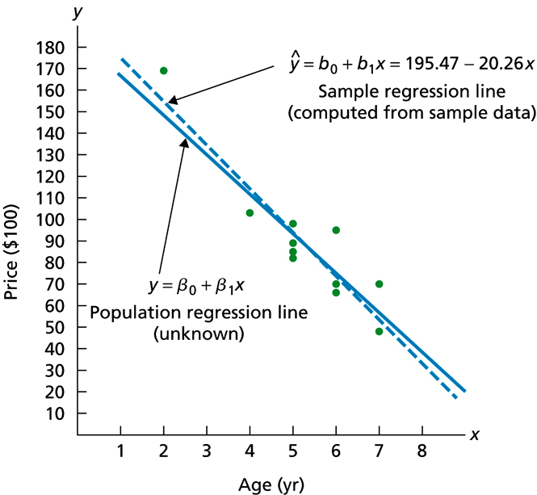
Figure 8.5-4
Population regression line and sample regression line for age and price of Orions

Slide 36
Definition 8.5.2
Standard Error of the Estimate
The standard error of the estimate,
is defined by
where S S E is the error sum of squares.

Slide 37
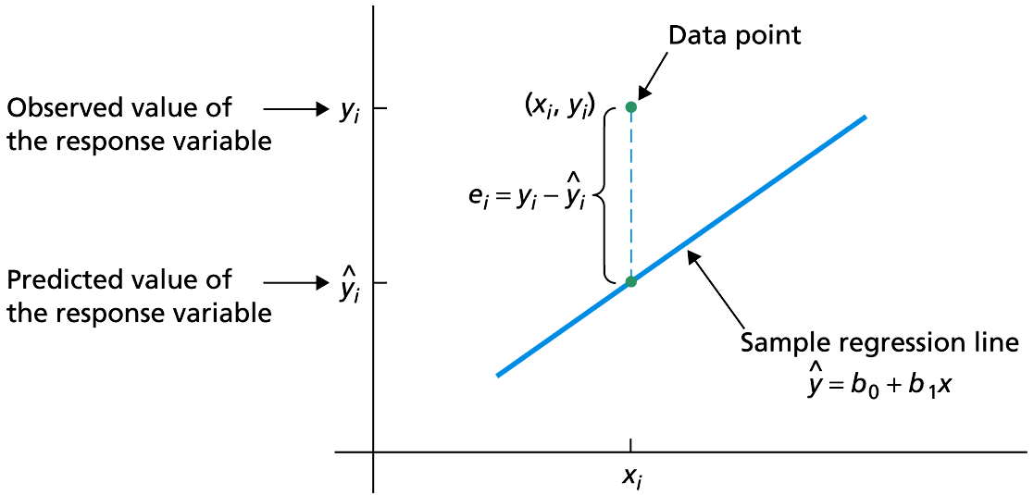
Figure 8.5-5
Residual of a data point

Slide 38
Key Fact 8.5.2
Residual Analysis for the Regression Model
If the assumptions for regression inferences are met, the following two conditions should hold:
A plot of the residuals against the observed values of the predictor variable should fall roughly in a horizontal band centered and symmetric about the x-axis.
A normal probably plot of the residuals should be roughly linear.
Failure of either of these two conditions casts doubt on the validity of one or more of the assumptions for regression inferences for the variables under consideration.

Slide 39
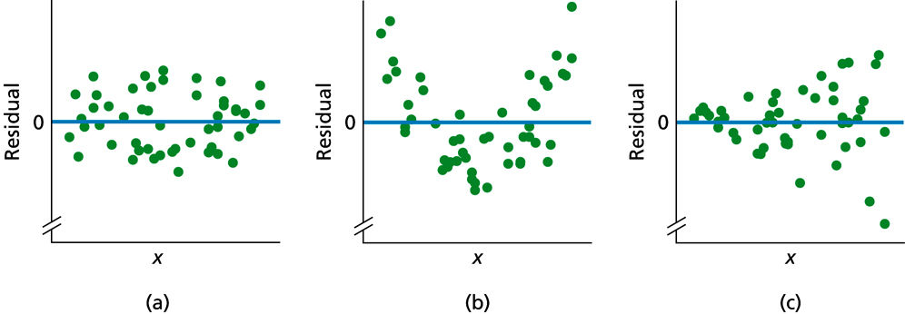
Figure 8.5-6
Residual plots suggesting (a) no violation of linearity or constant standard deviation, (b) violation of linearity, and (c) violation of constant standard deviation

Slide 40
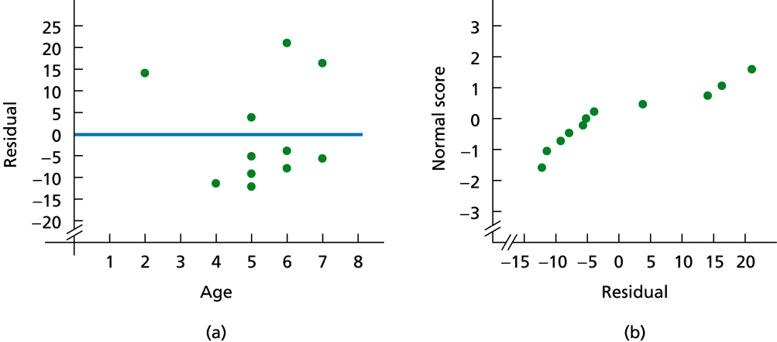
Figure 8.5-7
(a) Residual plot; (b) normal probability plot for residuals

